Slide 1
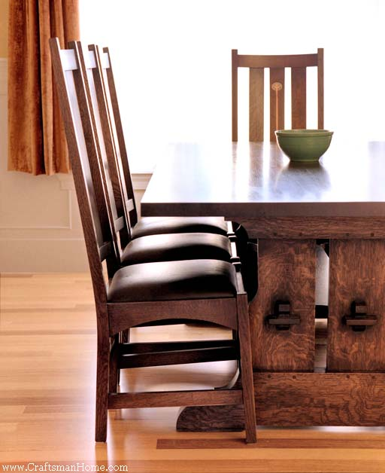
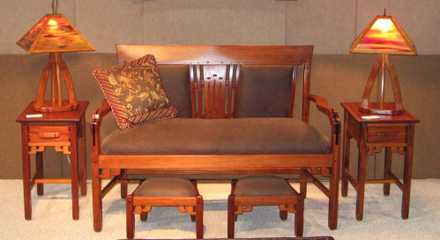

A Sampling of Furniture Periods/Styles That Influence Furniture Design
Fundamentals of Furniture Manufacturing
Travis Allen & Tom Gallenberg

Slide 2
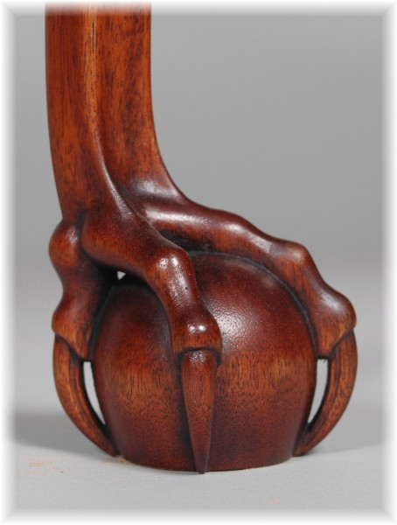
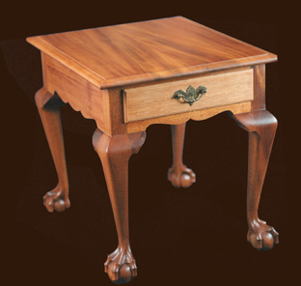
Queen Anne
An American style created in the early 18th century
  Most noted feature is the ball & claw cabriole leg
    Bowed and offset
  Preferred species = Walnut, but Maple, Cherry, and Mahogany were also used

Slide 3
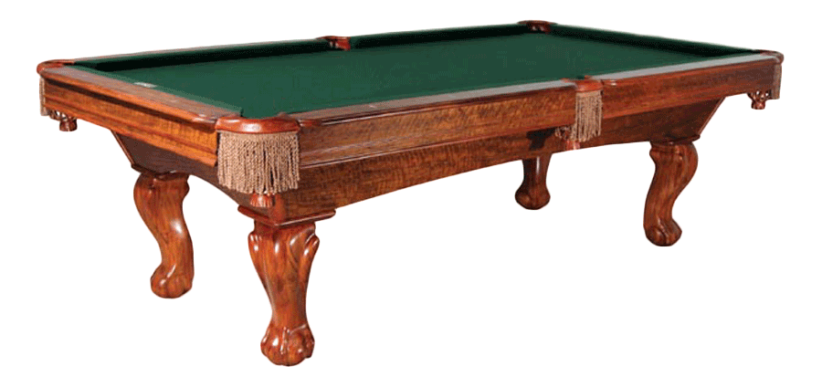
Queen Anne

Slide 4
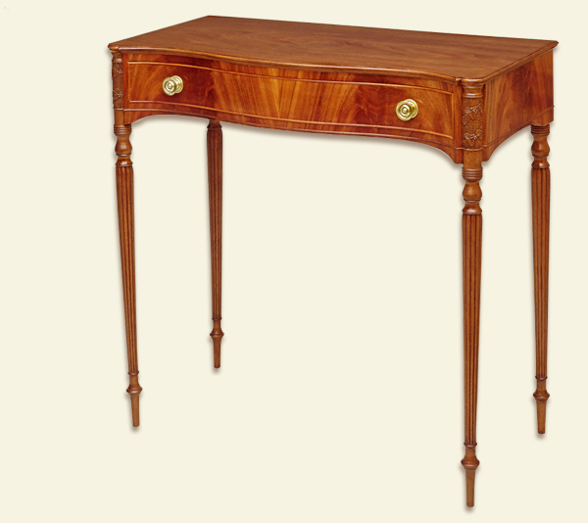
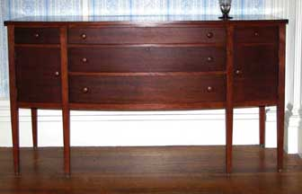
Federal Style
American’s reaction to Neo-classic English style during the late 18th century
  Most noted for simple geometric shaped furniture
    Light and delicate
  Details include fine inlays and refined turnings

Slide 5
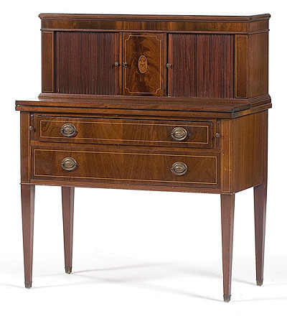
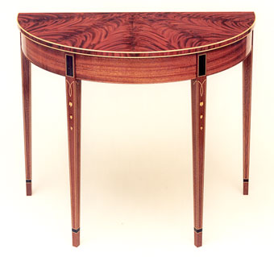
Federal Style

Slide 6
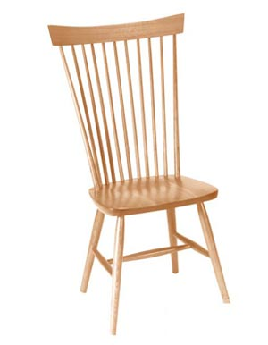
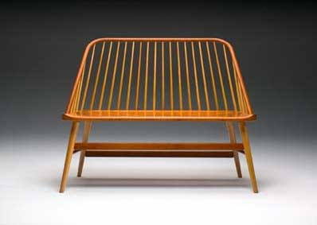
Shaker
Produced by the religious group “Shakers” during the early 19th century
  Simple, practical, and functional designs
    Plain turnings of a classic, straight back, Shaker chair is indicative of the design’s commitment to simplicity and function

Slide 7
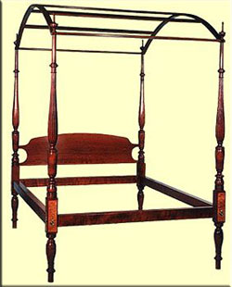
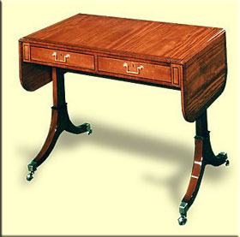
Sheraton
Designed by Thomas Sheraton, late 18th to early 19th centuries
  Neo-classical English style
  Features round tapered legs, fluting common
    Noted for contrasting veneer inlays
  Satinwood, Mahogany, Tulipwood
    Sycamore & Rosewood for inlaid decorations

Slide 8
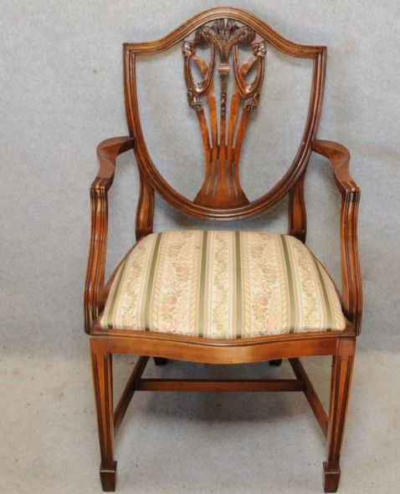
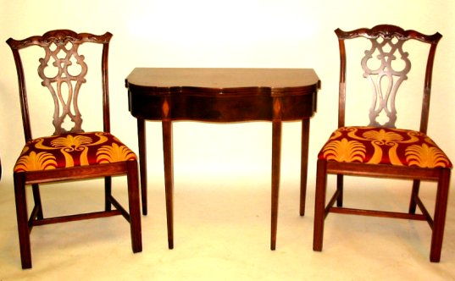
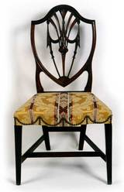
Hepplewhite
Designed by George Hepplewhite, 18th century
  Neo-classical English style
  Sometimes called “Federal Style” in the US
Hepplewhite chairs are smaller in size, with shield or heart shaped backs; slender legs, often tapering to a spade foot
  Painted or inlaid ornamentation

Slide 9
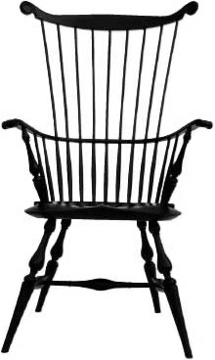
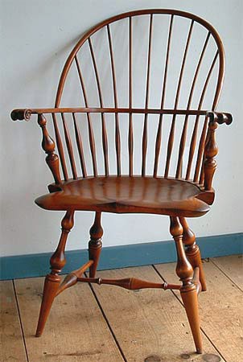
Windsor
Refers to a chair style of the 18th century
  Saddle-shaped seats and spindle backs are common

Slide 10
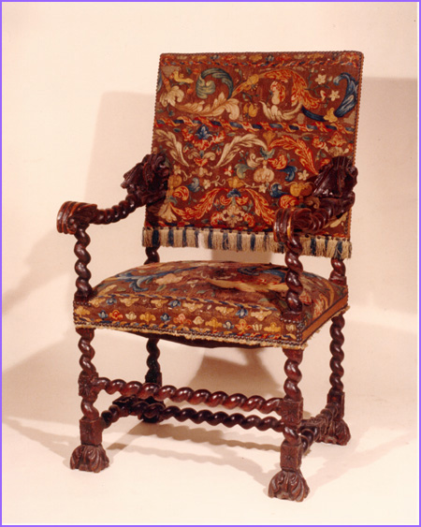
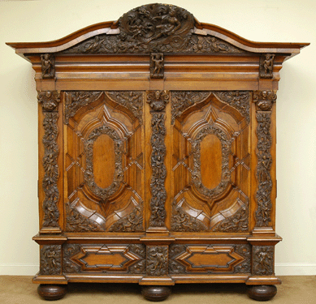
Baroque
Originated in Italy and was representative of the Roman Catholic Church, 17th & early 18th century
  Features include: twisted columns, broken pediments, heavy mouldings, details are related to the entire piece

Slide 11
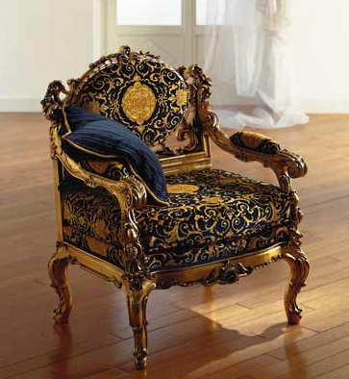
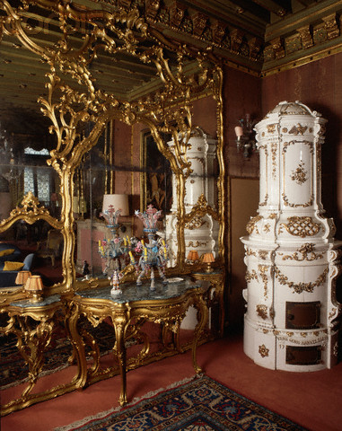
Baroque

Slide 12
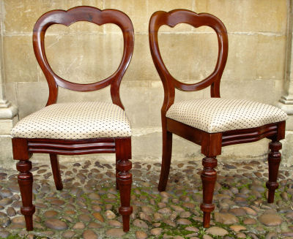
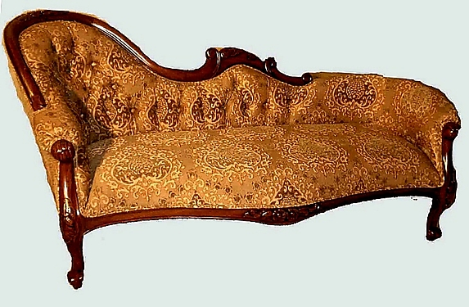
Victorian
Victorian period fell between 1837 to 1901
  Sparked by the industrial revolution and the mass production of furniture
  Noted for: heavy ornamentation, swirling & floral carvings
  The round ottoman, balloon back chair, and single end sofa were developed in this period

Slide 13
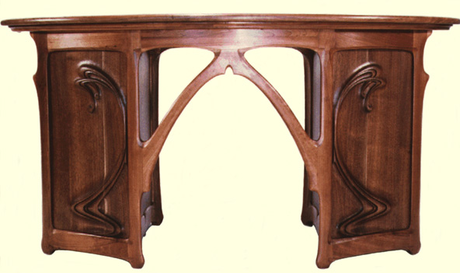
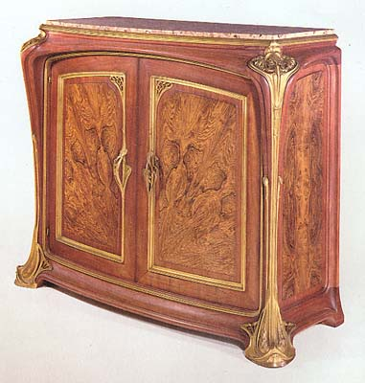
Art Nouveau
Popular in Europe between 1890 – 1920
  Went against the Victorian mainstream of that time
  A response against machine-made products
  Noted for: smoothly curving lines, often referred to as “whiplash lines”
  Used organic (plant like) forms of inspiration for the entire design rather than simply the ornamentation

Slide 14
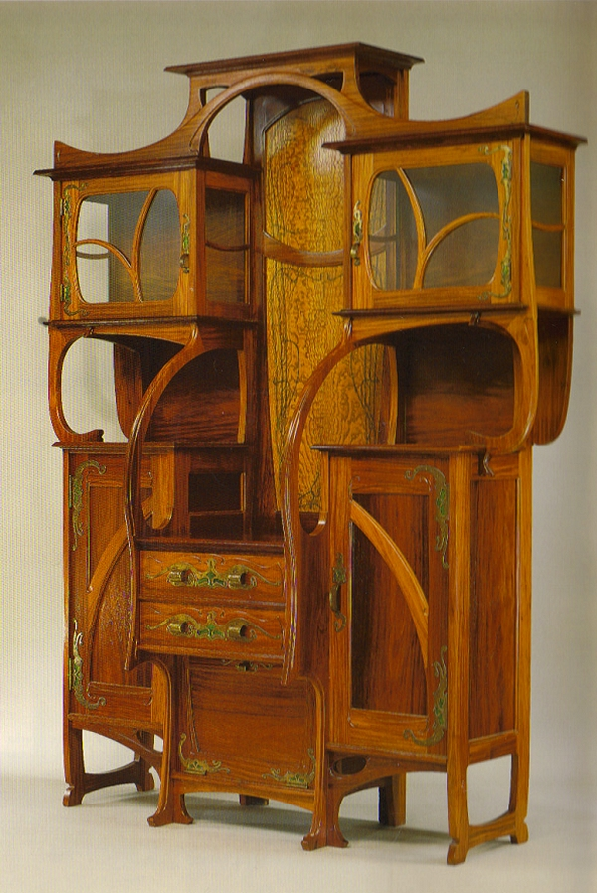
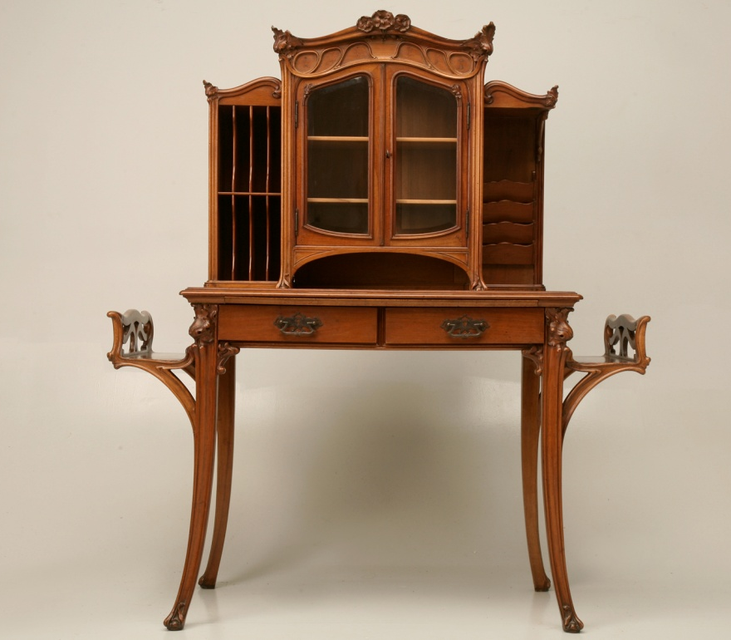
Art Nouveau

Slide 15
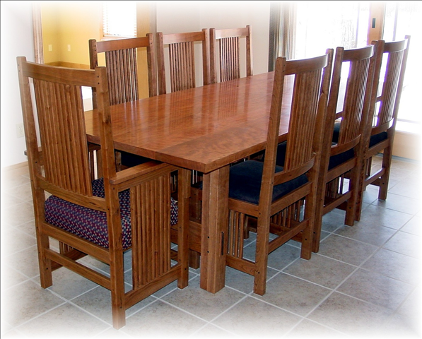
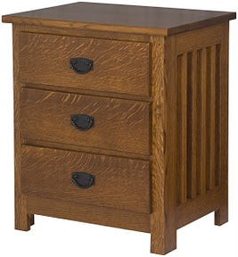
Mission
Popular in the early 20th century
  Inspired by mission furniture of the Southwest made of rough sawn lumber and pegs and dowels
  Popular offshoot from the Arts & Crafts period

Slide 16
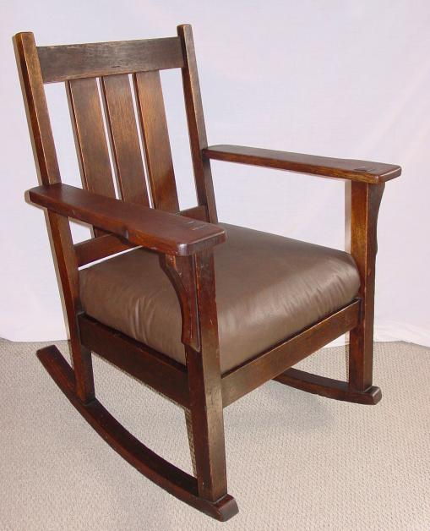
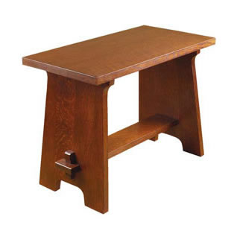
Mission
  Noted for simple, functional designs made of stained quartersawn oak with minimal ornamentation, straight lines and flat panels
  Leather and Native American designs often the motif for the coverings
  Designed for mass production

Slide 17
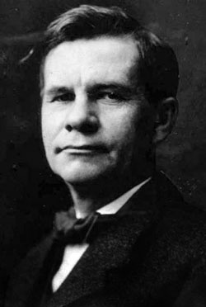
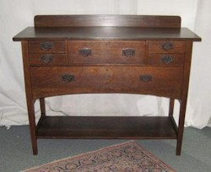
Stickley / Craftsman / Mission
Gustav Stickley a famous furniture designer of the late 1800s & early 1900s is noted for the birth of “Mission Style” which is used interchangeably with his “Craftsman Style”
Notes:
The term “Mission” developed from a humble start in a newspaper article where a salesman of the new Gustav Stickley Craftsman furniture line was traveling around selling orders for the items drawn in his little catalog. The salesman told a newspaper reporter that there was a table similar to “that one,” pointing to the drawing in his catalog, “in a Spanish Mission in Southern California.” The newspaper printed the term “Mission” in connection with the story’s headline and sidebar, and the name stuck across the country and “Mission” was born. So, in summary, Mission is Craftsman, and vice versa in today’s language.

Slide 18
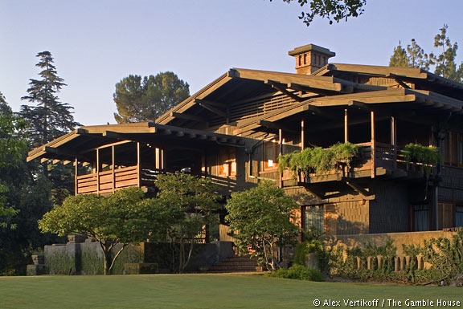
Greene & Greene
Part of the Arts & Crafts period
The architectural firm Greene & Greene was established in 1894 by the Greene brothers Charles & Henry
  Known for their custom “Ultimate Bungalows”
  Their unique design
  went beyond just furniture
  it included the
  Landscaping
  Lighting
  Glasswork
  Millwork
  Interior furnishings

Slide 19
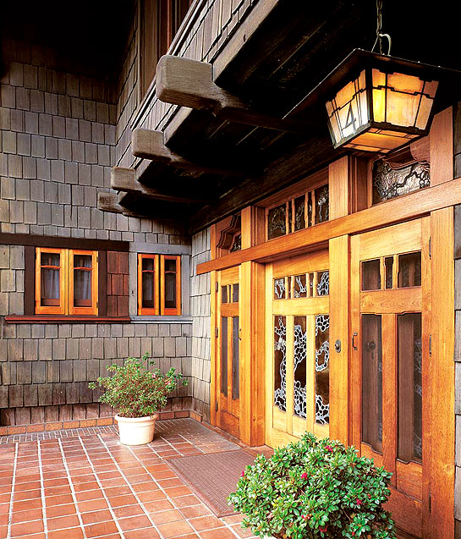
Greene & Greene
Unlike Stickley, Greene & Greene furniture was custom made for the wealthiest clients
Their style was influenced by
  Stickley’s Craftsman Style
  Japanese architecture
  Oriental design

Slide 20
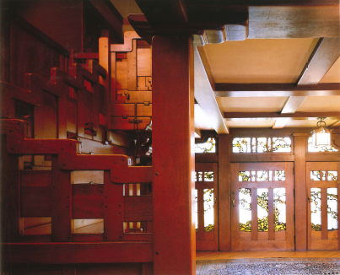
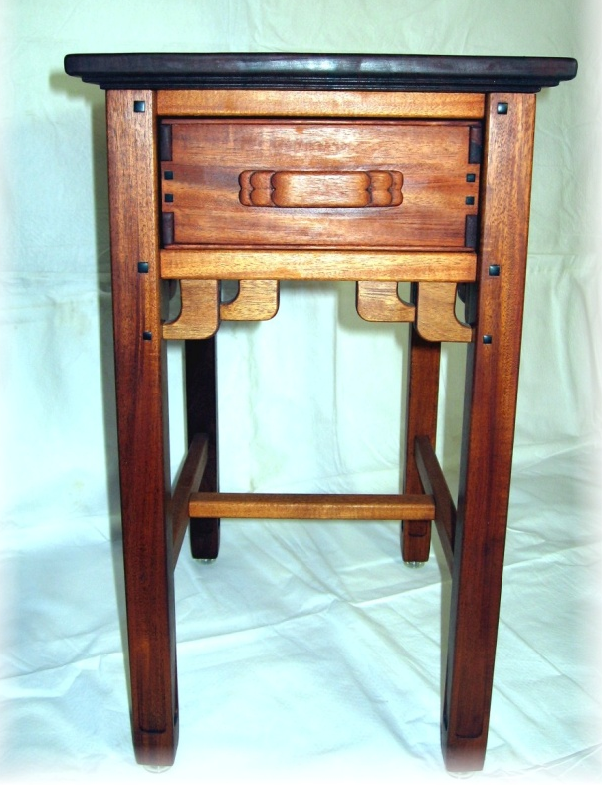
Greene & Greene
The design & furniture is most noted for
  Cloud lifts
  Flowing curves and subtly rounded edges
  Rarely do 2 flat surfaces intersect in the same plan

Slide 21
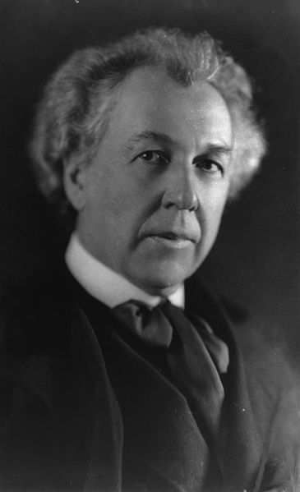
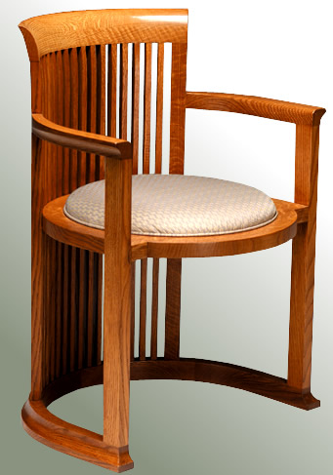
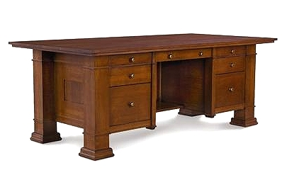
Frank Lloyd Wright
One of America’s Greatest Architects (1867 – 1959)
Also known for “Organic Architecture” and the “Prairie Style” of furniture

Slide 22
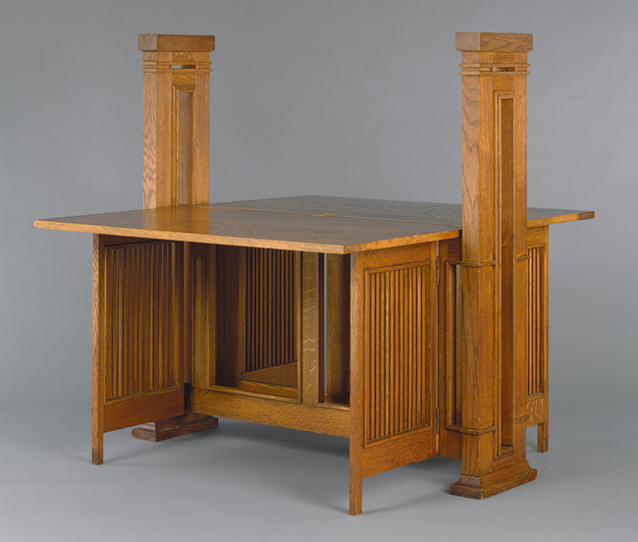
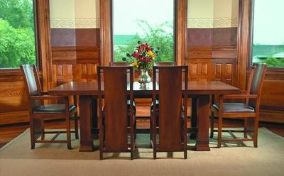
Frank Lloyd Wright
Part of the Art & Crafts Period
The Prairie Style is noted for straight lines, flared leg bottoms, relieved of unnecessary ornamentation, derived from nature

Slide 23
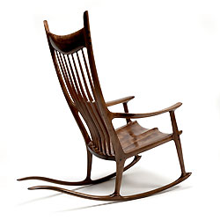
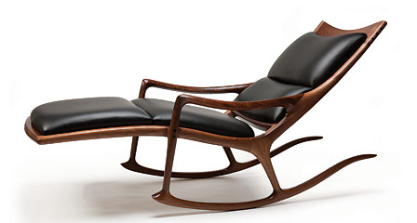
Sam Maloof
Famous furniture designer (1916 – 2009)
  Major part of the American Studio Furniture Movement
Noted for “clean sculpted lines born of practical consideration”, “innovative sculptured armrests”
Maloof freely shaped each piece

Slide 24
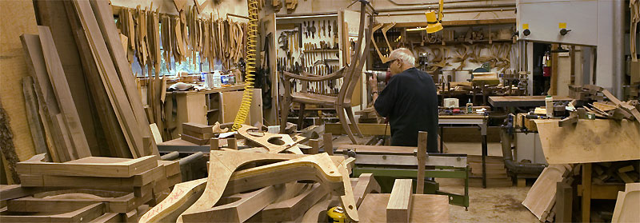
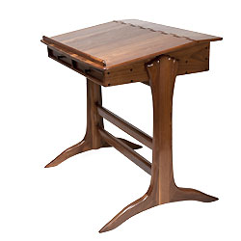
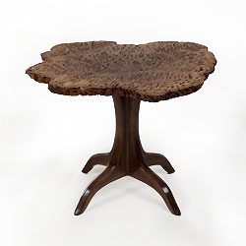
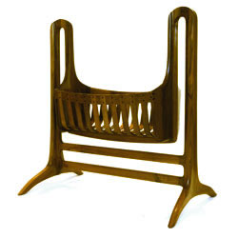
Sam Maloof

Slide 25
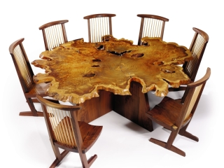

George Nakashima
Famous furniture designer (1905 – 1990)
  Major part of the American Studio Furniture Movement
Noted for using solid wood rather than veneer
  His work has been coined “organic” and some pieces called “slab furniture”
  Emphasized the natural configuration of the wood by incorporating unusual burls and free edges

Slide 26




George Nakashima

Slide 27
Sources
http://photos.gallenbergstudio.com/GalleryFilmstrip.aspx?gallery=1781685
http://www.pacifier.com/~wsmike/images/ball_and_claw_sidetable_thumbnail.jpg
http://www.theballandclaw.com/tea_table_goddard_foot.jpg
http://sutkus.com/images/federal_hall_table.jpg
http://www.buffaloah.com/f/fstyles/fed/tc.jpg
http://www.cowanauctions.com/itemImages/82267.jpg
http://www.shakerstyle.com/img/fanback/fanback-side.jpg
http://0.tqn.com/d/create/1/G/_/j/1/-/hepplewhite-chair.jpg
http://www.pachairmaker.com/images/home_chair.jpg
http://www.jamesdewandsons.com/images/chairs/1027-windsor-chair-front.jpg
http://luxury-idea.com/home-lux/wp-content/uploads/2011/07/dedalochair.jpg
http://designergirlee.files.wordpress.com/2011/03/european-baroque-interior-of-palazzo-dario-venice-italy.jpg
http://www.jbdesign.it/idesignpro/images/ArtNoveau/art.nouveau.desk.frt.jpg
http://www.artnouveaufurniture.com/images/MajorelleCabt.jpg
http://www.artnouveaufurniture.com/images/Bovy.jpg
http://www.antiques.com/vendor_item_images/ori_281_1399383336_1067121_5.jpg
http://www.thechairset.com/media/image/Set_8_balloon-1.jpg
http:/http://www.stickley.com/OurProducts_Details.cfm?id=1453&Collection=Mission&view=all&view=complex&finish
http://southwestspiritantiques.com/images/IG460-4.jpg
http://lh6.ggpht.com/_eImeuDtObGE/S-jXGk0fxgI/AAAAAAAAKCY/FBVgmm10qeg/s288/056-1200.jpg

Slide 28
Sources
http://www.stickleymuseum.org/craftsman-farms/gustav-stickley.html
http://ad009cdnb.archdaily.net/wp-content/uploads/2010/11/1290623587-vertikoff-2050629-03.jpg
http://www.gallenbergstudio.com/
http://www.restorations.net/mainstyl.htm
http://images.homeportfolio.com/1717/280215/400.jpg
http://www.metmuseum.org/toah/works-of-art/1972.60.8a,b
http://upload.wikimedia.org/wikipedia/commons/thumb/9/99/Frank_Lloyd_Wright_LC-USZ62-36384.jpg/220px-Frank_Lloyd_Wright_LC-USZ62-36384.jpg
http://www.horizon-custom-homes.com/Mission_Furniture.html
http://www.sam-maloof.com/legacy.htm
http://1.bp.blogspot.com/-w7cgMweaS9k/T3IFDO4jw8I/AAAAAAAAFdw/qs28g3aJPm8/s1600/m-bench-brcdesignscom.jpg
http://upload.wikimedia.org/wikipedia/commons/thumb/2/2c/Conoid_Chair_by_George_Nakashima,_1988.jpg/220px-Conoid_Chair_by_George_Nakashima,_1988.jpg
http://farm4.static.flickr.com/3219/2748567948_a058df38a0.jpg
http://farm1.staticflickr.com/27/52793227_3a4308e2cc.jpg
Bowman, L. G. 1990. American Arts & Crafts: Virtue in Design. Los Angeles , CA: Bulfinch Press
Cooke, E. S., Ward, G. W. R. , L’Ecuyer, K. H. 2003. The Maker’s Hand: American Studio Furniture, 1940 – 1990. Boston, MA: MFA Publications

